Slide 1

DATABASE MANAGEMENT SYSTEMS – CSE/IT – II Year / IV Sem. – 22CS403
Manju S,
AP/CoE,
RTC,Coimbatore.

Slide 2
TOPICS
DATABASE QUERYING
SQL: fundamentals – DDL – Specifying integrity constraints - DML – Basic retrieval queries in SQL - Complex SQL retrieval queries – nested queries – correlated queries – joins - Aggregate functions. Creating a table, populating data, adding integrity constraints, querying tables with simple and complex queries. DCL and TCL.

Slide 3
SQL : Structured Query Language
SQL (Structured Query Language) is a standard language designed for maintaining the data in a relational database management system.
With SQL, you can easily create and manage the data, create the tables, update or modify records in the databases, etc.
A database is a table that consists of rows and columns.
SQL is useful to retrieve specific information from the databases that are further used for analysis.
SQL is of 2 types i.e. SQL and NoSQL (Relational and Non Relational)

Slide 4
Relational vs. Non relational DB
A relational database stores correlated data in well-organized tables.
Non-relational databases represent those types of databases that may or may not adhere to any predefined input schema.
This property makes non-relational databases a lot more flexible than their relational counterparts.
They are also known as NoSQL or not only SQL databases. E.g.: MongoDB, Cassandra, and Redis etc.,

Slide 5
Types of databases in SQL
1. MySQL
MySQL is one of the most popular fully-managed database types in SQL-based management.
2. PostgreSQL
PostgreSQL is an advanced type of database in SQL management systems whichblends the traditional table-based approach with user-defined objects to create resilient databases supporting and analyzing complex and voluminous data.
3. SQLite
SQLite is a type of SQL database or storage engine structurally considered equivalent to a C library
4. Microsoft SQL Server
Microsoft SQL Server (MSSQL) is one of the most popular DBMS in SQL for innovative management solutions.
5. MariaDB
MariaDB is an open-source like MySQL.

Slide 6
SQL and Command types
SQL is used in programming and managing data held in relational database management systems such as MySql, MS SQL Server for accessing and interacting with data.
5 Types of SQL commands include
DDL(Data Definition Language):
To make/perform changes to the physical structure/schema of any table residing inside a database, DDL is used.
These commands when executed are auto-commit in nature and all the changes in the table are reflected and saved immediately.

Slide 7
SQL and Command types
DML(Data Manipulation Language):
Once the tables are created and the database is generated using DDL commands, manipulation inside those tables and databases is done using DML commands. (insert, delete, update)
The advantage of using DML commands is, that if in case any wrong changes or values are made, they can be changed and rolled back easily.
DQL(Data Query Language):
Data query language consists of only one command upon which data selection in SQL relies.
The SELECT command in combination with other SQL clauses is used to retrieve and fetch data from databases/tables based on certain conditions applied by the user.

Slide 8
SQL and Command types
DCL(Data Control Language):
DCL includes commands such as GRANT and REVOKE which mainly deal with the rights, permissions, authorization and other controls of the database system.
TCL(Transaction Control Language):
Transaction Control Language as the name suggests manages the issues and matters related to the transactions in any database.
They are used to roll back or commit the changes in the database.

Slide 9
DDL : Data Definition Language
In SQL DDL commands are used to create and modify the structure of a database and database objects.
Commands include,
CREATE,
DROP,
ALTER,
TRUNCATE, and
RENAME

Slide 10
DDL : Data Definition Language : CREATE
CREATE can be used to create a database as well as table
Syntax :
CREATE DATABASE database_name;
CREATE TABLE table_name(column1 datatype,column2 datatype, columnN datatype);
E.g.:
create database db1;
create table student( name varchar(10), id int);

Slide 11
DDL : Data Definition Language : DROP
Drop is used to delete/ drop the entire database or table
Syntax :
DROP DATABASE database_name;
DROP TABLE table_name;
E.g.:
drop database db1;
drop table student;

Slide 12
DDL : Data Definition Language : ALTER
The ALTER TABLE statement is used to add, delete, or modify columns in an existing table.
The ALTER TABLE statement is also used to add and drop various constraints on an existing table
Syntax :
ALTER TABLE TABLE_NAME ADD COLUMN column_name type;

Slide 13
DDL : Data Definition Language : ALTER
E.g.: Alter table student add column marks int;
Table student will have an extra column added named marks
How to change the datatype of existing column?
Syntax : ALTER TABLE table_name ALTER COLUMN column_name TYPE new_type;
E.g. : alter table student alter column marks type varchar(7);
Column type would have changed from int to varchar.
Name | Id | marks

Slide 14
DDL : Data Definition Language : ALTER
Dropping an existing column
Syntax:
ALTER TABLE table_name DROP COLUMN column_name;
E.g : alter table student drop column id;
Renaming a existing column
Syntax :
ALTER TABLE table_name RENAME COLUMN current_name TO new_name;
E.g : alter table student rename column marks to finalmarks;
Name | marks
Name | finalmarks

Slide 15
DDL : Data Definition Language : ALTER(rename)
Renaming a table
Syntax :
ALTER TABLE current_name RENAME TO new_name;
E.g.: alter table student rename to student_new;
Renaming a database
Syntax :
ALTER DATABASE current_name RENAME TO new_name;
E.g. : alter database db1 rename to newdb;

Slide 16
DDL : Data Definition Language : ALTER
Setting default value
Syntax :
ALTER TABLE table_name ALTER COLUMN column_name SET DEFAULT default_value;
E.g.: alter table student_new alter column marks set default 50;
Removing default value
Syntax :
ALTER TABLE table_name ALTER COLUMN column_name DROP DEFAULT;
E.g.: alter table student_new alter column marks drop default;

Slide 17
DDL : Data Definition Language : TRUNCATE
TRUNCATE statement is used to quickly remove all rows from a set of tables, essentially resetting them to empty.
It's much faster than deleting rows one by one .
Deleted data can’t be rolled back!
Syntax :
TRUNCATE TABLE table_name;
TRUNCATE TABLE table1, table2, table3; (multiple tables)
E.g. : truncate table student;
All rows would have been deleted

Slide 18
DML : Data Manipulation Language
Data Manipulation Language (DML) refers to the subset of SQL commands used to add, update, and delete data in the database.
DML commands do not alter the schema or structure of the database itself.
DML commands include ,
Insert
Delete
Update

Slide 19
Just to know! Meta commands in PSQL
\c : Connect to the database
\q : Quits PSQL
\dt : lists all the tables in a database
\l or \list : lists all the databases
\h : provide helps about psql commands

Slide 20
DML : Data Manipulation Language : INSERT
Insert is used to add one or more rows into the table
Syntax :
All column insertion :
INSERT INTO table_name VALUES (value1, value2, ...);
E.g.: insert into student values(‘abc’,101,67);
Specific column insertion:
INSERT INTO table_name (column1, column2, ...) VALUES (value1, value2, ...);
E.g.: insert into student (name, id) values (‘xyz’,102);
Name | Id | Marks
Name | Id | Marks
Abc | 101 | 67
Xyz | 102

Slide 21
DML : Data Manipulation Language : DELETE
DELETE is used to delete existing records in a table.
All record deletion
Syntax :
DELETE FROM table_name;
E.g.: delete from student;
Deletes all the record of specified table.
Specific record deletion : use where clause
DELETE FROM table_name where condition;
E.g.: delete from student where id=1;
Delete from student where marks<50;

Slide 22
DML : Data Manipulation Language : UPDATE
It is used to update the data of an existing table in the database.
All record updation : [ single column updation]
Syntax :
UPDATE table_name SET column_name = value;
E.g. : update student set marks=100; [ all the students marks will be updated to 100]
Selective record updation:
Syntax :
UPDATE table_name SET column1 = value1 where condition;
E.g. : update student set marks=100 where id=1; [student having id 1 has a update of 100 for mark column]

Slide 23
DML : Data Manipulation Language : UPDATE
All record updation : [ Multiple column updation]
Syntax :
UPDATE table_name SET column_name1 = value, column_name2=value2….;
E.g. :
update student set marks=100,phone=03439893 where id=1;
Student having id 1 will have an update on 2 columns namely marks and phone

Slide 24
DQL : Data Query Language : SELECT
SELECT is used to retrieve back the data from tables
All records:
SELECT * FROM table_name;
E.g.: select * from student;
Selective records :
SELECT * FROM table_name WHERE CONDITION;
E.g.: select * from student where marks >90;

Slide 25
Integrity constraints
Integrity constraints are pre-defined set of rules that are applied on the table fields(columns) or relations to ensure that the overall validity, integrity, and consistency of the data present in the database table .
Evaluation of all the conditions or rules mentioned in the integrity constraint is done every time a table insert, update, delete, or alter operation is performed.
The data can be inserted, updated, deleted, or altered only if the result of the constraint comes out to be True.
Thus, integrity constraints are useful in preventing any accidental damage to the database by an authorized user.

Slide 26
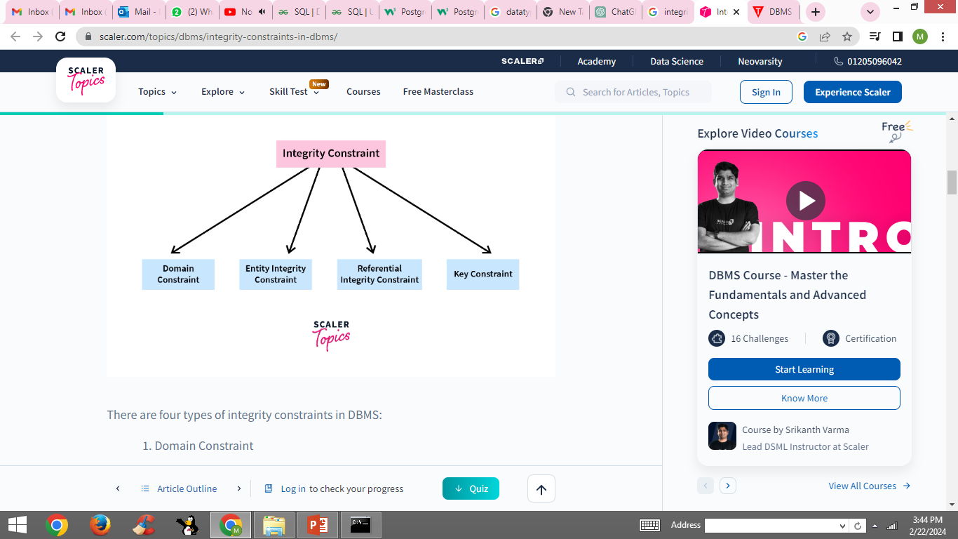
Types of Integrity Constraints
Domain Constraint
Entity Integrity Constraint
Referential Integrity Constraint
Key Constraint

Slide 27
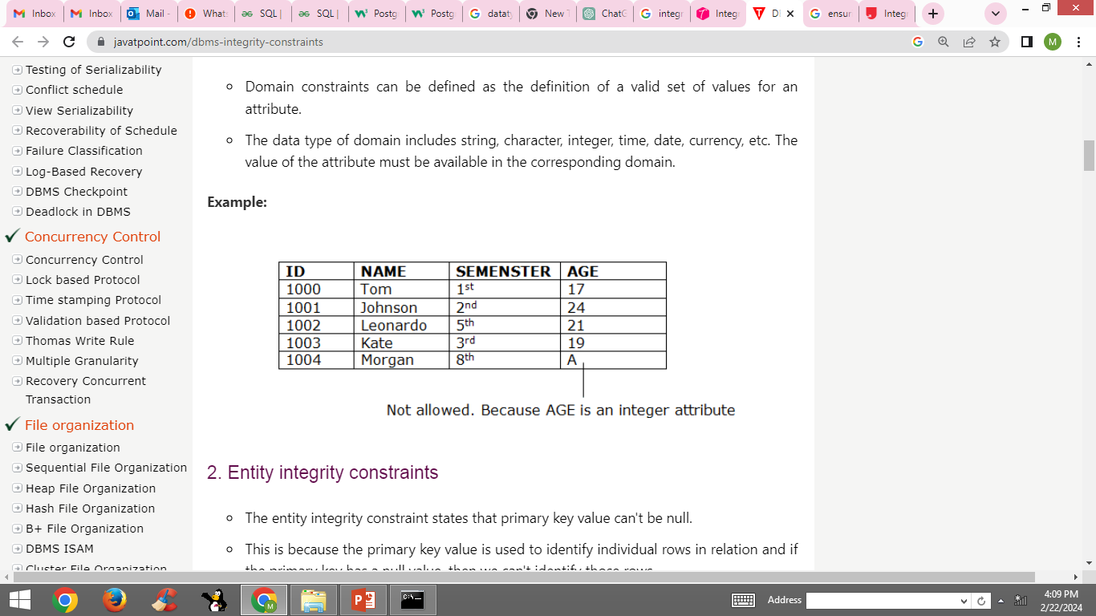
Domain constraint
This is a set of rules or conditions to restrict the kind of values a column/ attribute can hold in the database table.
The data type of a domain can be int, char, varchar, float, etc.,
Giving a character value to an integer violates integrity!

Slide 28
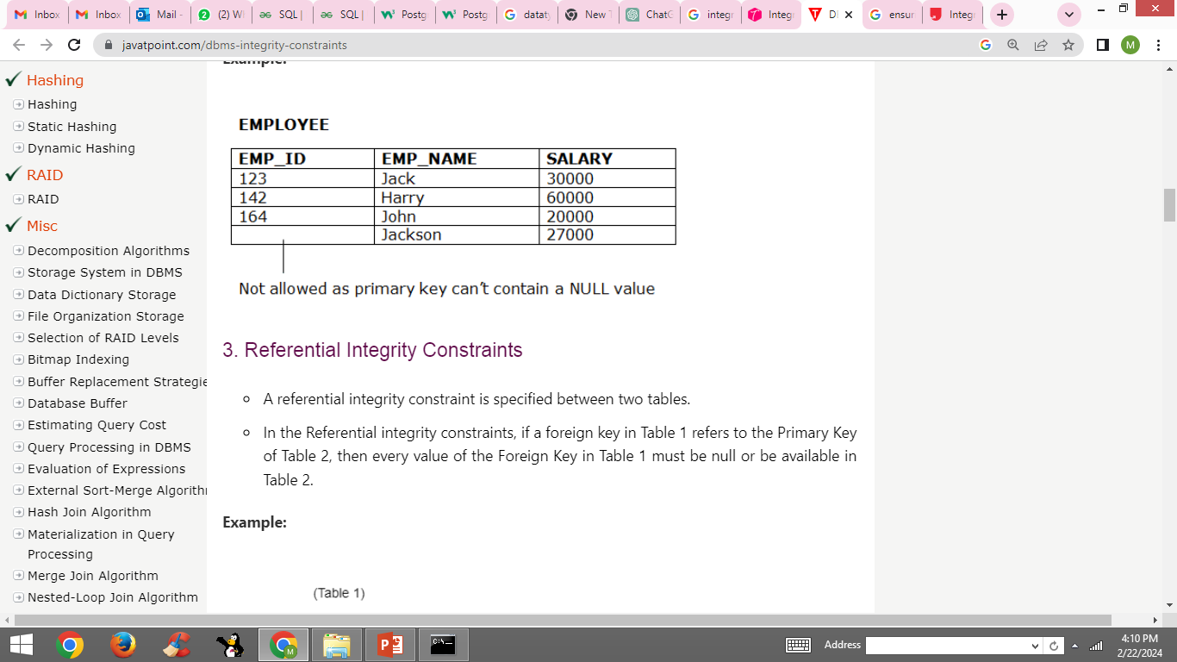
Entity Integrity Constraint (Primary Key)
Entity Integrity Constraint is used to ensure that the primary key cannot be null.
A primary key is used to identify individual records in a table and if the primary key has a null value, then we can't identify those records.
There can be null values anywhere in the table except the primary key column.

Slide 29
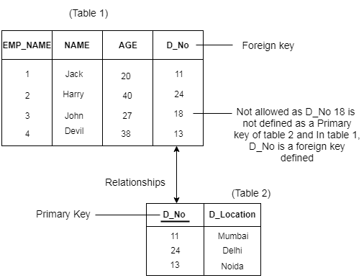
Referential Integrity Constraint (Foreign Key)
This ensures that there must always exist a valid relationship between two relational database tables.
This valid relationship between the two tables confirms that a foreign key exists in a table.
It should always reference a corresponding value or attribute in the other table or be null.

Slide 30
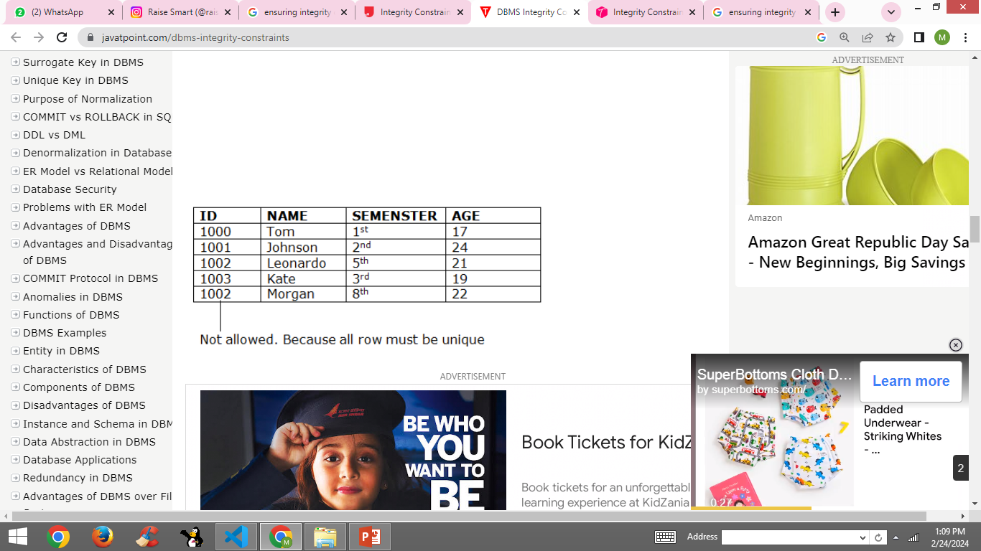
Key Constraint
Keys are the set of entities that are used to identify an entity within its entity set uniquely.
There could be multiple keys in a single entity set, but out of these multiple keys, only one key/combination of keys will be the primary key.

Slide 31
Ensuring constraints : Not Null
The NOT NULL constraint specifies that a column in a table must not contain any null values.
It ensures that a particular attribute or field cannot be left empty or undefined for any record in the table.
E.g.: create table customer(cust_id int primary key,
cust_name varchar(10) not null, cust_age int not null );

Slide 32
Ensuring constraints : Check
The CHECK constraint explains a condition that must be satisfied for the values in a column(s).
It allows you to limit the range of acceptable values based on a specific condition or expression
E.g.: create table customer( cust_id int primary key ,
cust_salary float check (cust_salary>0) );

Slide 33
Ensuring constraints : Primary key
The PRIMARY KEY constraint identifies each record in a table uniquely.
It enforces the uniqueness and non-null property of one or more columns in a table.
A primary key can consist of a single column or a combination of multiple columns.
E.g.: create table student(stu_id int primary key,
stu_name varchar(10) not null );

Slide 34
Ensuring constraints : Foreign key
The FOREIGN KEY constraint creates a relationship between two tables based on the values of a column or columns.
It helps maintain referential integrity by enforcing that the values in a specific column(s) of one table correspond to those of a primary key in another table.
E.g: create table course( course_id int primary key, stu_id int, foreign key(stu_id) references student(stu_id));

Slide 35
Ensuring constraints : Unique
The UNIQUE Constraint prevents two records from having identical values in a particular column.
It allows null values to be stored.
E.g.: create table student(stu_id int primary key,
stu_name varchar(10) not null, adhaarid bigint unique);

Slide 36
Ensuring constraints : Default
The DEFAULT constraint is used to set a default value for a column in a table.
If we insert a row into the table without specifying a value for this column, PostgreSQL will insert the default value specified.
E.g.: create table student(stu_id int primary key,
stu_name varchar(10) not null, department varchar(7) default ‘IT’);

Slide 37
Ensuring constraints in 2 ways!
Constraints can be specified at either the column level or the table level, and understanding the difference between these two approaches is essential for effective database design and management
2 ways of specifying constraints
Column level constraints
Table level constraints

Slide 38
Column level constraints
Column level constraints apply to a single column in a table.
They are defined directly inline with the column definition.
These constraints are easy to read and understand because they are placed right next to the column they pertain to.
E.g.:
CREATE TABLE employees ( eid int PRIMARY KEY, email varchar(255) UNIQUE NOT NULL, age integer CHECK (age > 18));

Slide 39
Table level constraints
Table-level constraints refer to one or more columns in the table provided at the end after specifying all the columns of a table.
Table-level constraints specify the names of the columns to which they apply.
E.g.:
CREATE TABLE employees (adharid LONG INT ,email VARCHAR(255), age INT,PRIMARY KEY (adharid, email), NOT NULL (age));

Slide 40
Difference and use cases!
Column-Level Constraints are best used when the rule or restriction is specific to a single column.
Table-Level Constraints are more suited for rules that involve multiple columns or the entire table.

Slide 41
Observations! Not null at table level!
Can I use table level method for imposing not null on multiple attributes in PSQL?
PostgreSQL syntax requires NOT NULL constraints to be specified at the column level.
There's no separate syntax for defining these constraints at the table level in the way that PRIMARY KEY or UNIQUE constraints can be defined.

Slide 42
Observations! : foreign key at column level!
Foreign key constraint at column level uses a different syntax of not needing to mention foreign key keyword.
Parent table :
Create table tt(id int primary key, name varchar(9));
Child table :
Create table cc(id int references tt(id), contact longint);
When mentioned references SQL compiler will understand it will act as foreign key.
While foreign key at table level needs the keyword foreign key!

Slide 43
Do it yourself!
Create and manipulate a database schema for a university system that manages information about students, courses, and enrollments.
Ensure tight bounds by designing tables with all constraints whenever required!
Insert at least 5 records into each table, ensuring some students are enrolled in multiple courses.

Slide 44
An example Schema for student enrollment !
Students table with the following fields:
student_id (Primary Key, Integer)
name (Varchar, Not Null)
email (Varchar, Unique, Not Null)
major (Varchar)
Courses table with the following fields:
course_id (Primary Key, Integer)
course_name (Varchar, Not Null)
credits (Integer, Not Null)
Enrollments table to link students with courses, including fields for grades:
enrollment_id (Primary Key, Integer)
student_id (Foreign Key, Integer, References Students)
course_id (Foreign Key, Integer, References Courses)
grade (Varchar)
Ensure referential integrity between Students, Courses, and Enrollments

Slide 45
Queries to work on!
Write an SQL query to insert a new student into the Students table. The student's name is "Alex Smith", their email is "alex.smith@email.com", and their major is "Computer Science”.
Write an SQL query to select all fields of all students from the Students table.
Write an SQL query to change the major of a student with the student_id of 2 to "Data Science”
Write an SQL query to delete the student record where the student_id is 3
Write an SQL query to find all students majoring in "Maths"

Slide 46
Queries to work on!
6. Write a query to delete a student record whose id is 1. Consider the impact of this deletion on related tables.
Hint : Observe if deletion is permitted or not!
Error : Foreign key violation error?? Isn't it?!

Slide 47
Need for cascading !
Consider a database with a "customer_details" and an "order_details" table.
The "order_details" table is linked with the "customer_details" table through a foreign key constraint.
Suppose a user wants to delete a customer from the "customer_details" table.
Then to keep the database clean and organized, he might also want to delete all of the orders associated with that customer from the "order_details" table.
This is where Postgres DELETE CASCADE feature is extremely useful!

Slide 48
On Delete Cascade in PSQL
To use a delete cascade in Postgres, specify the "ON DELETE CASCADE" option while creating/defining a foreign key constraint.
This tells Postgres to automatically delete any rows in the referenced table that are related to the row being deleted in the referencing table.

Slide 49
On Delete Cascade in PSQL
CREATE TABLE parent (id INT PRIMARY KEY,
name VARCHAR(255) NOT NULL);
CREATE TABLE child ( id SERIAL PRIMARY KEY, parent_id INT, name VARCHAR(255) NOT NULL, FOREIGN KEY (parent_id) REFERENCES parent(id) ON DELETE CASCADE);
Now deleting the data in parent table will cascade the change to child as well.

Slide 50
On Update Cascade in PSQL
CREATE TABLE parent (id INT PRIMARY KEY,
name VARCHAR(255) NOT NULL);
CREATE TABLE child ( id SERIAL PRIMARY KEY, parent_id INT, name VARCHAR(255) NOT NULL, FOREIGN KEY (parent_id) REFERENCES parent(id) ON DELETE CASCADE ON UPDATE CASCADE);
This would also cascade updates made in parent to child.

Slide 51
Complex SQL retrieval queries
Complex SQL queries include
Nested queries: One query embedded within another
Co-related nested queries: The output of an inner query depends on the row being executed in an outer query
Joining tables: Joining from many tables and using different join types
Functions within functions: Using functions within functions

Slide 52
Nested queries
A nested query is a query that appears inside another query, and it helps retrieve data from multiple tables or apply conditions based on the results of another query.
For instance, a nested query can have two SELECT statements, one on the inner query and the other on the outer query.
The result of inner query is used in execution of outer query.
Nested queries in SQL can be classified into two different types:
Independent Nested Queries (Non correlated)
Co-related Nested Queries

Slide 53
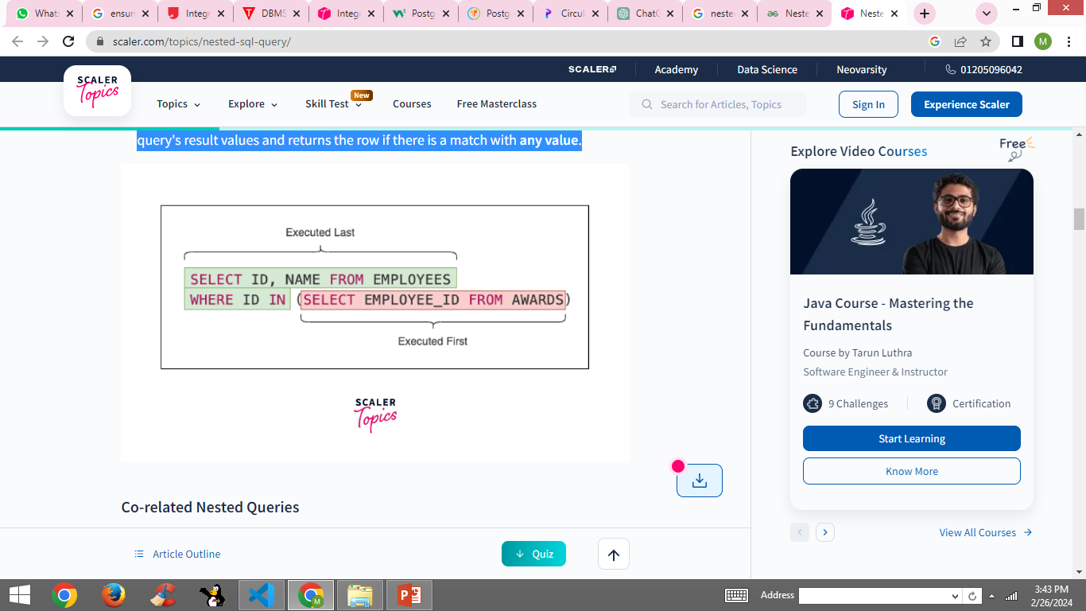
Independent nested queries
In independent nested queries, the execution order is from the innermost query to the outer query.
An outer query won't be executed until its inner query completes its execution.
The outer query uses the result of the inner query.
Operators such as IN, NOT IN, ALL, and ANY are used to write independent nested queries.

Slide 54
Independent nested queries : Operators
The IN operator checks if a column value in the outer query's result is present in the inner query's result. The final result will have rows that satisfy the IN condition.
The NOT IN operator checks if a column value in the outer query's result is not present in the inner query's result. The final result will have rows that satisfy the NOT IN condition.
The ALL operator compares a value of the outer query's result with all the values of the inner query's result and returns the row if it matches all the values.
The ANY operator compares a value of the outer query's result with all the inner query's result values and returns the row if there is a match with any value.

Slide 55
How to write nested queries ?
SELECT column_name [, column_name ]
FROM table1 [, table2 ]
WHERE column_name OPERATOR
( SELECT column_name [, column_name ]
FROM table1 [, table2 ]
[WHERE]
);

Slide 56
Nested queries example
id | name | salary | role
1 | Augustine Hammond | 10000 | Developer
2 | Perice Mundford | 10000 | Manager
3 | Cassy Delafoy | 30000 | Developer
4 | Garwood Saffen | 40000 | Manager
5 | Faydra Beaves | 50000 | Developer
CREATE TABLE Employees (
id int PRIMARY KEY,
name VARCHAR(100) NOT NULL,
salary int NOT NULL,
role VARCHAR(100) NOT NULL
);
CREATE TABLE Awards(
id int PRIMARY KEY,
employee_id int NOT NULL,
award_date DATE NOT NULL
);
id | employee_id | award_date
1 | 1 | 2022-04-01
2 | 3 | 2022-05-01

Slide 57
Independent Nested queries example
Select names of all employees who won an award.
SELECT id, name FROM Employees
WHERE id IN (SELECT employee_id FROM Awards);
Select names of all employees who never won an award.
SELECT id, name FROM Employees
WHERE id NOT IN (SELECT employee_id FROM Awards);

Slide 58
Independent Nested queries example
Select all Developers who earn more than all the Managers.
SELECT * FROM Employees WHERE role = 'Developer' AND salary > ALL ( SELECT salary FROM Employees WHERE role = 'Manager');
Select all Developers who earn more than any Manager.
SELECT * FROM Employees WHERE role = 'Developer' AND salary > ANY (SELECT salary FROM Employees WHERE role = 'Manager');

Slide 59
Correlated nested queries
In co-related nested queries, the inner query uses the values from the outer query to execute the inner query for every row processed by the outer query.
The co-related nested queries run slowly because the inner query is executed for every row of the outer query's result.

Slide 60
Correlated nested queries example
Select all employees whose salary is above the average salary of employees in their role
SELECT * FROM Employees emp1 WHERE salary > ( SELECT AVG(salary) FROM Employees emp2 WHERE emp2.role = emp1.role);
The inner query is executed for all rows fetched by the outer query. The inner query uses the role value (emp1.role) of every outer query's row (emp1.role = emp2.role).
Emp1 and emp2 are alias names for the result sets of outer and inner query respectively.

Slide 61
To do! Examples of Nested Queries!
Consider a database with two tables, Employees and Departments, with the following simplified structures:
Employees(employee_id, name, salary, department_id)
Departments(department_id, department_name)
Find the names of all employees who work in the 'IT' department.
Find the names of employees who have the highest salary in their respective departments.

Slide 62
More examples for nested queries
SELECT name FROM Employees WHERE department_id in (
SELECT department_id FROM Departments WHERE department_name = 'IT');
SELECT e.name FROM Employees e WHERE e.salary = (
SELECT MAX(salary) FROM Employees WHERE department_id = e.department_id);

Slide 63
Joins
A PostgreSQL Join statement is used to combine data or rows from one(self-join) or more tables based on a common field between them.
These common fields are generally the Primary key of the first table and Foreign key of other tables.
4 basic types of joins supported by PostgreSQL, namely:
Inner Join
Left Join
Right Join
Full Outer Join
Some special PostgreSQL joins are below:
Natural Join, Cross Join, Self Join

Slide 64
Schema for joins
CREATE TABLE employees (employee_id SERIAL PRIMARY KEY,employee_name VARCHAR(255), department_id INT);
CREATE TABLE departments (department_id SERIAL PRIMARY KEY, department_name VARCHAR(255));
Insert appropriate values !

Slide 65
Schema for joins
employee_id | employee_name | department_id
1 | John Doe | 1
2 | Jane Smith | 2
3 | Alice Johnson | NULL
4 | Chris Evans | 3
5 | Emma Watson | 2
6 | Robert Downey | 4
7 | Scarlett Johansson | NULL
department_id | department_name
1 | HR
2 | Marketing
3 | Engineering
4 | Finance
5 | Research
6 | Customer Service
7 | Legal

Slide 66
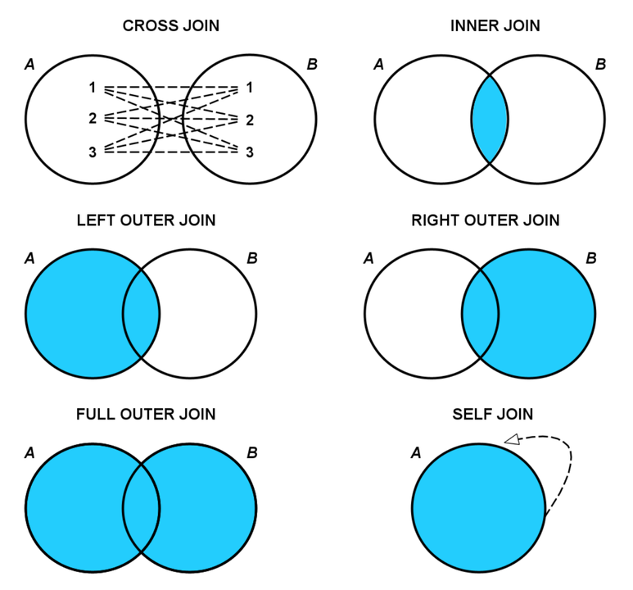
Inner join
This keyword will create the result-set by combining all rows from both the tables where the condition satisfies i.e value of the common field will be the same.
SELECT table1.column1,table1.column2,table2.column1, FROM table1 INNER JOIN table2 ON table1.matching_column = table2.matching_column;

Slide 67
Inner join example
SELECT e.employee_name, d.department_name FROM employees e INNER JOIN departments d ON e.department_id = d.department_id;
Only matched rows of both tables
employee_name | department_name
John Doe | HR
Jane Smith | Marketing
Chris Evans | Engineering
Emma Watson | Marketing
Robert Downey | Finance

Slide 68
Left Outer Join / Left Join
The LEFT JOIN returns all the rows from the left table and the matched rows from the right table.
If there is no match, NULL values are returned for columns from the right table.
SELECT table1.column1,table1.column2,table2.column1,.... FROM table1 LEFT JOIN table2 ON table1.matching_column = table2.matching_column;

Slide 69
Left outer join example
SELECT e.employee_name, d.department_name FROM employees e LEFT JOIN departments d ON e.department_id = d.department_id;
Matched rows of both tables + Unmatched rows of left table
employee_name | department_name
John Doe | HR
Jane Smith | Marketing
Alice Johnson | NULL
Chris Evans | Engineering
Emma Watson | Marketing
Robert Downey | Finance
Scarlett Johansson | NULL

Slide 70
Right Join / Right Outer Join
The RIGHT JOIN returns all the rows from the right table and the matched rows from the left table.
If there is no match, NULL values are returned for columns from the left table.
SELECT table1.column1,table1.column2,table2.column1,.... FROM table1 RIGHT JOIN table2 ON table1.matching_column = table2.matching_column;

Slide 71
Right Outer Join example
SELECT e.employee_name, d.department_name FROM employees e RIGHT JOIN departments d ON e.department_id = d.department_id;
employee_name | department_name
John Doe | HR
Jane Smith | Marketing
Chris Evans | Engineering
Robert Downey | Finance
Emma Watson | Marketing
NULL | Research
NULL | Customer Service
NULL | Legal
Matched rows of both tables + Unmatched rows of Right table

Slide 72
Full Join / Full Outer Join
FULL JOIN creates the result-set by combining results of both LEFT JOIN and RIGHT JOIN.
The result-set will contain all the rows from both tables.
For the rows for which there is no matching, the result-set will contain NULL values.
SELECT table1.column1,table1.column2,table2.column1,.... FROM table1 FULL JOIN table2 ON table1.matching_column = table2.matching_column;

Slide 73
Full Join example
employee_name | department_name
John Doe | HR
Jane Smith | Marketing
Alice Johnson | NULL
Chris Evans | Engineering
Emma Watson | Marketing
Robert Downey | Finance
Scarlett Johansson | NULL
NULL | Research
NULL | Customer Service
NULL | Legal
SELECT e.employee_name, d.department_name FROM employees e FULL JOIN departments d ON e.department_id = d.department_id;
Matched rows of both tables + Unmatched rows of both of Left and Right table

Slide 74
Cross Join
A CROSS JOIN is a SQL operation that produces the Cartesian product of two tables.
This means it joins every row of the first table with every row of the second table.
If the first table has N rows and the second table has M rows, the result set will have N * M rows, assuming there are no filters applied to the query.
CROSS JOINs are used when you need to combine each item of one table with every item of another table, often for combinatorial purposes or to generate exhaustive pairs of records for analysis.
SELECT columns FROM table1 CROSS JOIN table2;

Slide 75
Cross join example
SELECT e.employee_name, d.department_name FROM employees e CROSS JOIN departments d;
This will produce a Cartesian product of the two tables, resulting in 49 rows (7 employees * 7 departments), with every combination of employee and department.
Given the large number of combinations, but each employee will be paired with each department once.

Slide 76
Cross join Output
employee_name | department_name
John Doe | HR
John Doe | Marketing
John Doe | Engineering
John Doe | Finance
John Doe | Research
John Doe | Customer Service
John Doe | Legal
Jane Smith | HR
Jane Smith | Marketing
Jane Smith | Engineering
Jane Smith | Finance
Jane Smith | Research
Jane Smith | Customer Service
Jane Smith | Legal
Emma Watson | HR
Emma Watson | Marketing
Emma Watson | Engineering
Emma Watson | Finance
Emma Watson | Research
Emma Watson | Customer Service
Emma Watson | Legal
Robert Downey | HR
Robert Downey | Marketing
Robert Downey | Engineering
Robert Downey | Finance
Robert Downey | Research
Robert Downey | Customer Service
Robert Downey | Legal
Alice Johnson | HR
Alice Johnson | Marketing
Alice Johnson | Engineering
Alice Johnson | Finance
Alice Johnson | Research
Alice Johnson | Customer Service
Alice Johnson | Legal
Chris Evans | HR
Chris Evans | Marketing
Chris Evans | Engineering
Chris Evans | Finance
Chris Evans | Research
Chris Evans | Customer Service
Chris Evans | Legal

Slide 77
Cross join Output
Scarlett Johansson | HR
Scarlett Johansson | Marketing
Scarlett Johansson | Engineering
Scarlett Johansson | Finance
Scarlett Johansson | Research
Scarlett Johansson | Customer Service
Scarlett Johansson | Legal
Note :
All 49 rows will be displayed as single result set
Considering the slide size, result set is split and displayed in 2 different slides!

Slide 78
Note !!!!
Use with Caution: Since CROSS JOINs produce a Cartesian product, the size of the result set can grow exponentially with the number of rows in the joined tables. Large result sets can consume significant computational resources and slow down database performance.
Purposeful Use: CROSS JOINs are less commonly used in typical database operations compared to INNER JOINs, LEFT JOINs, etc. They are most useful in specific analytical tasks or when generating exhaustive lists of combinations for particular purposes.

Slide 79
Self Join
A Self Join is a join in which a table is joined with itself.
Self Joins are useful when you need to compare rows within the same table.
A self join can be performed by using either an INNER JOIN, LEFT JOIN, or any other join type, depending on the requirements.
To differentiate the same table being joined, you typically use aliases for the table name.
SELECT a.column_name, b.column_name FROM table_name AS a JOIN table_name AS b ON a.common_field = b.common_field;

Slide 80
Self join example
SELECT a.employee_name AS Employee1, b.employee_name AS Employee2, a.department_id FROM employees a INNER JOIN employees b ON a.department_id = b.department_id AND a.employee_id < b.employee_id;
Employee1 | Employee2 | department_id
Jane smith | Emma Watson | 2

Slide 81
Venn Diagrams for all joins

Slide 82
Natural joins
A NATURAL JOIN automatically joins tables based on columns with the same names and compatible data types in both tables.
It implicitly matches columns between the tables.
There is no need to specify the column names on which to join because it automatically uses the columns with the same names in both tables.
The resulting table will contain all the attributes of both tables but keeps only one copy of each common column
SELECT * FROM TABLE1 NATURAL JOIN TABLE2;

Slide 83
Natural joins Example
SELECT table_1.column_name(s), table_2.column_name(s) FROM table_1 NATURAL [ INNER, LEFT, RIGHT ] JOIN table_2;
E.g. :
SELECT e.employee_name, d.department_name FROM employees e Natural Join departments d
employee_name | department_name
John Doe | HR
Jane Smith | Marketing
Chris Evans | Engineering
Emma Watson | Marketing
Robert Downey | Finance

Slide 84
Difference between inner and natural join
NATURAL JOIN | INNER JOIN
Natural Join joins two tables based on same attribute name and datatypes. | Inner Join joins two table on the basis of the column which is explicitly specified in the ON clause.
In Natural Join, The resulting table will contain all the attributes of both the tables but keep only one copy of each common column | In Inner Join, The resulting table will contain all the attribute of both the tables including duplicate columns also
In Natural Join, If there is no condition specifies then it returns the rows based on the common column | In Inner Join, only those records will return which exists in both the tables
Syntax- SELECT * FROM table1 NATURAL JOIN table2; | Syntax- SELECT * FROM table1 INNER JOIN table2 ON table1.Column_Name= table2.Column_Name;

Slide 85
Column difference between natural and inner join
Assume table1 and table 2 as follows
SELECT * FROM A NATURAL JOIN B;
Output had avoided printing common and id attributes twice but thrown it once
id | name | common
1 | Alice | X
2 | Bob | Y
id | color | common
1 | Red | X
2 | Blue | Z
id | name | common | color
1 | Alice | X | Red
2 | Bob | Y | Blue

Slide 86
Column difference between natural and inner join
SELECT * FROM A INNER JOIN B ON A.id = B.id;
Output of inner join will print id and common attribute twice accounting one from A and another from B.
Repetition of columns happens in inner join.
id | name | common | id | color | common
1 | Alice | X | 1 | Red | X
2 | Bob | Y | 2 | Blue | Z

Slide 87
Aggregate functions
PostgreSQL supports several aggregate functions, which are used to perform calculations on a set of values and return a single value.
PSQL provides many aggregate functions that include avg, count, sum, min, max, etc. An aggregate function ignores NULL values when it performs the calculation, except for the count function.

Slide 88
Schema for Aggregate functions!
eid | ename | sal
1 | John | 50000
2 | Doe | 60000
3 | Jane | 55000
4 | Smith | 65000
5 | Emily | 70000
6 | NULL | NULL
7 | NULL | 50000

Slide 89
Count () : across entire table
Count(*) : Counts the number of rows in a set, including rows with NULL values.
SELECT COUNT(*) as total_employees FROM employees;
eid | ename | sal
1 | John | 50000
2 | Doe | 60000
3 | Jane | 55000
4 | Smith | 65000
5 | Emily | 70000
6 | NULL | NULL
7 | NULL | 50000
total_employees
7

Slide 90
Count() : across specific column
Count(Column_Name) : Presents the count of non-null values in the specified column
SELECT COUNT(ename) as total_employees FROM employees;
eid | ename | sal
1 | John | 50000
2 | Doe | 60000
3 | Jane | 55000
4 | Smith | 65000
5 | Emily | 70000
6 | NULL | NULL
7 | NULL | 50000
total_employees
5

Slide 91
Count() : with distinct
Count(Distinct Column_Name) : Presents the count of non-null and unique values in the specified column
SELECT COUNT( distinct sal) as tot_sal FROM employees;
eid | ename | sal
1 | John | 50000
2 | Doe | 60000
3 | Jane | 55000
4 | Smith | 65000
5 | Emily | 70000
6 | NULL | NULL
7 | NULL | 50000
Tot_sal
5

Slide 92
Sum ()
Aggregates the sum of all non-null values in the specified column.
SELECT sum(sal) as total_sal FROM employees;
eid | ename | sal
1 | John | 50000
2 | Doe | 60000
3 | Jane | 55000
4 | Smith | 65000
5 | Emily | 70000
6 | NULL | NULL
7 | NULL | 50000
total_sal
350000

Slide 93
Sum () : with distinct
Aggregates the sum of all non-null and unique values in the specified column.
SELECT sum(distinct sal) as total_dis_sal FROM employees;
eid | ename | sal
1 | John | 50000
2 | Doe | 60000
3 | Jane | 55000
4 | Smith | 65000
5 | Emily | 70000
6 | NULL | NULL
7 | NULL | 50000
total_dis_sal
300000

Slide 94
Avg ()
Computes the average score by dividing the sum of all non null values by the count of non-null values in the specified column.
SELECT avg(sal) as avg_sal FROM employees;
eid | ename | sal
1 | John | 50000
2 | Doe | 60000
3 | Jane | 55000
4 | Smith | 65000
5 | Emily | 70000
6 | NULL | NULL
7 | NULL | 50000
Avg_sal
58333.3333

Slide 95
Avg () with distinct
Computes the distinct average score by dividing the sum of all distinct non null values by the count of distinct non-null values in the specified column.
SELECT avg( distinct sal) as avg_dis_sal FROM employees;
eid | ename | sal
1 | John | 50000
2 | Doe | 60000
3 | Jane | 55000
4 | Smith | 65000
5 | Emily | 70000
6 | NULL | NULL
7 | NULL | 50000
Avg_dis_sal
60,000

Slide 96
Min()
Identifies the minimum value in the specified column, excluding null values.
SELECT min(sal) as mini FROM employees;
eid | ename | sal
1 | John | 50000
2 | Doe | 60000
3 | Jane | 55000
4 | Smith | 65000
5 | Emily | 70000
6 | NULL | NULL
7 | NULL | 50000
mini
50000

Slide 97
Max()
Identifies the minimum value in the specified column, excluding null values.
SELECT max(sal) as max_sal FROM employees;
eid | ename | sal
1 | John | 50000
2 | Doe | 60000
3 | Jane | 55000
4 | Smith | 65000
5 | Emily | 70000
6 | NULL | NULL
7 | NULL | 50000
max_sal
70000

Slide 98
Do it yourself!
Consider the following movie schema
ARTIST (Art_id, Art_Name, Art_Gender)
PRODUCER (Prod_id, Prod_Name, Prod_Phone)
FILMS (Film_id, Film_Title, Film_Year, Film_Lang, Prod_id)
CASTING (Art_id, Film_id, Part)
REVIEW (Film_id, Stars)

Slide 99
Do it Yourself ! Assume the following data!
Art_id | Art_Name | Art_Gender
101 | AMIT | M
102 | PRITAM | M
103 | SREYA | F
104 | SUJATA | F
Prod_id | Prod_Name | Prod_Phone
200 | ADITYA | 6735835863
201 | FARAN | 8654297433
202 | YASH | 8765421567
203 | NIRAJ | 7654321986
Art_id | Film_id | Part
101 | 12 | ACTOR
101 | 11 | ACTOR
103 | 13 | ACTRESS
103 | 12 | GUEST
104 | 14 | ACTRESS
Film_id | Film_Title | Film_Year | Film_Lang | Prod_id
11 | WAR 2 | 2017 | ENGLISH | 201
12 | MOMENTS | 2015 | HINDI | 203
13 | THE MAY | 2019 | ENGLISH | 201
14 | BHANUMATI | 2014 | TELUGU | 200
Film_id | Stars
11 | 4
12 | 2
13 | 5
14 | 4

Slide 100
Questions to work on : SQL Queries
Find the name of all the Films whose producer is “NIRAJ”
Display all artists who acted in a film between 2016 and 2018.
Display the names of films with the stars received and sort the result on the basis of stars.
Update the stars of all films whose producer is ‘NIRAJ’ to 5.

Slide 101
SQL Queries : Nested queries
1. Select film_title from films where prod_id in (select prod_id from producer where prod_name = ‘niraj’);
2. Select a.Art_name, f.Film_title, f.Film_year from artist a, casting c, films f where a.Art_id=c.Art_id and c.Film_id=f.Film_id and f.Film_year between 2016 and 2018;
or
Select Art_name From Artist where Art_id In ( Select Art_id From Casting Where Film_id in (Select Film_id From Films where Film_year Between 2016 And 2018));
3. Select f.Film_title, r_stars from films f, review r where f.Film_id=r.Film_id order by r.Stars desc ;
4. Update review set stars=5 where film_id in (select film_id from films where prod_id in (select prod_id from producer where prod_name = ‘niraj’));

Slide 102
SQL queries : with Joins
1. SELECT F.Film_Title FROM FILMS F
INNER JOIN PRODUCER P ON F.Prod_id = P.Prod_id
WHERE P.Prod_Name = 'NIRAJ';
2. SELECT DISTINCT A.Art_Name
FROM ARTIST A INNER JOIN CASTING C ON A.Art_id = C.Art_id
JOIN FILMS F ON C.Film_id = F.Film_id
WHERE F.Film_Year BETWEEN 2016 AND 2018;

Slide 103
SQL queries : with Joins
3. SELECT F.Film_Title, R.Stars
FROM FILMS F LEFT JOIN REVIEW R ON F.Film_id = R.Film_id ORDER BY R.Stars DESC;
4. UPDATE REVIEW SET Stars = 5 WHERE Film_id IN (
SELECT F.Film_id FROM FILMS F INNER JOIN PRODUCER P ON F.Prod_id = P.Prod_id
WHERE P.Prod_Name = 'NIRAJ');

Slide 104
Conditional clauses
In PostgreSQL (PSQL), conditional clauses are fundamental parts of the SQL language, allowing for filtering, sorting, and grouping of data, respectively
Categories include,
WHERE,
ORDER BY, and
GROUP BY
HAVING

Slide 105
Employee table for conditional clauses!
employee_id | name | department | salary | join_date
1 | Alice | HR | 70000 | 2020-01-10
2 | Bob | IT | 80000 | 2019-08-15
3 | Charlie | Marketing | 60000 | 2021-03-22
4 | Diana | IT | 90000 | 2018-05-11
5 | Ethan | HR | 75000 | 2021-06-01
6 | Fiona | Marketing | 65000 | 2020-02-14
7 | George | IT | 85000 | 2022-07-19
8 | Hannah | HR | 68000 | 2019-11-23

Slide 106
Where clause
The WHERE clause is used to filter records based on specified conditions.
It is used in SELECT, UPDATE, DELETE, etc., to select only those rows that satisfy the condition given by the WHERE clause.
E.g.:
SELECT * FROM employees WHERE department = ‘IT';
employee_id | name | department | salary | join_date
2 | Bob | IT | 80000 | 2019-08-15
4 | Diana | IT | 90000 | 2018-05-11
7 | George | IT | 85000 | 2022-07-19

Slide 107
Order by clause
The ORDER BY clause is used to sort the result set of a query by one or more columns.
We can sort the results in ascending (default) or descending order.
Ascending Order Default : E.g. :
SELECT * FROM employees ORDER BY join_date;
Descending Order: E.g. :
SELECT * FROM employees ORDER BY join_date desc;

Slide 108
Order by Ascending : Default
SELECT * FROM employees ORDER BY join_date ;
employee_id | name | department | salary | join_date
4 | Diana | IT | 90000 | 2018-05-11
2 | Bob | IT | 80000 | 2019-08-15
8 | Hannah | HR | 68000 | 2019-11-23
1 | Alice | HR | 70000 | 2020-01-10
6 | Fiona | Marketing | 65000 | 2020-02-14
3 | Charlie | Marketing | 60000 | 2021-03-22
5 | Ethan | HR | 75000 | 2021-06-01
7 | George | IT | 85000 | 2022-07-19

Slide 109
Order by Descending : desc
SELECT * FROM employees ORDER BY join_date desc;
employee_id | name | department | salary | join_date
7 | George | IT | 85000 | 2022-07-19
5 | Ethan | HR | 75000 | 2021-06-01
3 | Charlie | Marketing | 60000 | 2021-03-22
1 | Alice | HR | 70000 | 2020-01-10
6 | Fiona | Marketing | 65000 | 2020-02-14
8 | Hannah | HR | 68000 | 2019-11-23
2 | Bob | IT | 80000 | 2019-08-15
4 | Diana | IT | 90000 | 2018-05-11

Slide 110
Ascending order : ASC
SELECT * FROM employees ORDER BY salary ASC;
employee_id | name | department | salary | join_date
3 | Charlie | Marketing | 60000 | 2021-03-22
6 | Fiona | Marketing | 65000 | 2020-02-14
8 | Hannah | HR | 68000 | 2019-11-23
1 | Alice | HR | 70000 | 2020-01-10
5 | Ethan | HR | 75000 | 2021-06-01
2 | Bob | IT | 80000 | 2019-08-15
7 | George | IT | 85000 | 2022-07-19
4 | Diana | IT | 90000 | 2018-05-11

Slide 111
Group by clause
The PostgreSQL GROUP BY clause is used in collaboration with the SELECT statement to group together those rows in a table that have identical data.
This is done to eliminate redundancy in the output and/or compute aggregates that apply to these groups.
The GROUP BY clause follows the WHERE clause in a SELECT statement and precedes the ORDER BY clause.
The GROUP BY clause groups rows that have the same values in specified columns into summary rows, like "find the number of employees in each department". It is often used with aggregate functions (COUNT(), MAX(), MIN(), SUM(), AVG()).

Slide 112
Group by clause
SELECT department, AVG(salary) AS average_salary FROM employees GROUP BY department;
Groups the results by the department so that the avg_sal is calculated for each distinct department.
department | average_salary
HR | 71000
IT | 85000
Marketing | 62500

Slide 113
Group by clause
SELECT department, COUNT(employee_id) AS countperdep FROM employees GROUP BY department;
Groups the results by the department so that the count is calculated for each distinct department.
department | countperdep
HR | 3
IT | 3
Marketing | 2

Slide 114
Having clause
HAVING clause in SQL is used to filter data based on conditions that apply to groups, rather than to individual rows.
It's often used in combination with the GROUP BY clause to filter groups or aggregates.
The HAVING clause is necessary because the WHERE clause cannot be used to filter aggregated data

Slide 115
Having clause
SELECT department, AVG(salary) AS average_salary FROM employees GROUP BY department HAVING AVG(salary) > 80000;
department | average_salary
IT | 85000

Slide 116
TCL
TCL commands allow us to manage the transactions in your database.
A transaction is a unit of work that is performed against a database.
It's either completely performed or completely failed. TCL commands:
BEGIN: Starts a transaction.
COMMIT: Saves the changes made by the transaction.
ROLLBACK: Undoes the changes made by the transaction.
SAVEPOINT: Creates points within a transaction to which you can roll back.
RELEASE SAVEPOINT: Removes a savepoint.

Slide 117
TCL : Begin and Commit
cid | name | balance
1 | a | 7000
2 | b | 2000
3 | c | 3000
4 | d | 4000
To do
Deduct 1000 from ‘a’
Credit the 1000 to ‘b’
Either both updates should happen or not even one
BEGIN;
UPDATE accounts SET balance = balance - 1000 WHERE name = ‘a’;
UPDATE accounts SET balance = balance + 1000 WHERE name = ‘b’;
COMMIT;
Select * from accounts;
cid | name | balance
1 | a | 6000
2 | b | 3000
3 | c | 3000
4 | d | 4000

Slide 118
TCL : Rollback [ complete rollback]
Begin;
Insert into accounts values(45,’manju’,5856990);
Update accounts SET balance = balance - 1000 WHERE name = ‘a’;
Update accounts set balance = balance + 1000 where name = ‘b’;
select * from accounts;
Rollback;
All Changes ( 2 updates and 1 insert) made in the transaction will be undone or rolled back.
Say, I want to undo only the updates while my insert should stay still?
Checkpoints!!

Slide 119
Why Save points / Checkpoints ?
Checkpoints/ Save points allow you to define points within a transaction to which you can roll back, without rolling back the entire transaction.
This feature is useful when we have a long transaction that involves multiple steps, and we want the ability to undo some of those steps without starting over from the beginning.
Syntax for creating a save point:
Savepoint savepoint_name;
Syntax for rolling back to savepoint
Rollback to savepoint savepoint_name;

Slide 120
TCL : Rollback with Save Points
Begin;
Insert into accounts values(45,’manju’,5856990);
Savepoint s1;
Update accounts SET balance = balance - 1000 WHERE name = ‘a’;
Select * from accounts;
Update accounts set balance = balance + 1000 where name = ‘b’;
select * from accounts;
Rollback to savepoint s1;
Commit;
In this case two updates will be rolled back while the insert done will stand still.

Slide 121
Observations!
TCL wont directly throw us the outputs. We can check the happenings by viewing the respective tables or relations.
Select * from accounts;
cid | name | balance
1 | a | 6000
2 | b | 3000
3 | c | 3000
4 | d | 4000
45 | manju | 5856990

Slide 122
Releasing Save points
After creating a savepoint, if we decide on the fact that we are not going to roll back to that specific point in our transaction, we can release the savepoint.
This allows the system to free up resources associated with maintaining the savepoint.
Syntax :
Release savepoint savepoint_name;

Slide 123
Just to know! Meta commands in PSQL
\c : Connect to the database
\q : Quits PSQL
\dt : lists all the tables in a database
\l or \list : lists all the databases
\h : provide helps about psql commands
\conninfo: to know which database we have connected at the moment as which user.

Slide 124
DCL
DCL includes commands such as GRANT and REVOKE, which are used to control access to data in the database.
These commands allow you to manage the rights users have, such as the right to access, modify, or administer databases.
GRANT: Gives user(s) access privileges to the database.
REVOKE: Removes access privileges from user(s).
Syntax:
Grant [permissions/previliges] on [table_name/db_name] to [user_name];

Slide 125
Exploring DCL with tables!
Working with tables and databases differ in privileges!

Slide 126
DCL : Permissions for table!
Privilege | Description
SELECT | Ability to perform SELECT statements on the table.
INSERT | Ability to perform INSERT statements on the table.
UPDATE | Ability to perform UPDATE statements on the table.
DELETE | Ability to perform DELETE statements on the table.
TRUNCATE | Ability to perform TRUNCATE statements on the table.
REFERENCES | Ability to create foreign keys (requires privileges on both parent and child tables)
TRIGGER | Ability to create triggers on the table.
CREATE | Ability to perform CREATE TABLE statements.
ALL | Grants all permissions.

Slide 127
DCL : Creating a new user and granting permission!
Login into PSQL using the default user login ‘postgres’ and create a table ‘dcldemo’ in default database ‘postgres’. Insert data if required !
Create a new user using the following syntax,(staying at postgres user login)
Create user user_name password ‘password’;
E.g.: create user manit password ‘123’;
A user with a name ‘manit’ and password ‘123’ will be created.
Grant permission to the user ‘manit’ for select command on the table ‘dcldemo’
E.g.: grant select on dcldemo to manit;

Slide 128
Login back to PSQL as the other user created(manit)
Permission denied for the insert operation on the user ‘manit’ over the table ‘dcldemo’ in the databse ‘postgre’. Since user ‘manit’ is given with only select privilege!!
Server [localhost]:
Database [postgres]:
Port [5432]:
Username [postgres]: manit
Password for user manit:
psql (16.1)
postgres=> select * from dcldemo;
id | name
----+------
(0 rows)
postgres=> insert into dcldemo values(1,'g');
ERROR: permission denied for table dcldemo
postgres=>

Slide 129
DCL : Revoke
Revoke statement is used to remove previously granted privileges from a user (role)
Grant [permissions/previliges] on [table_name/db_name] to [user_name];

Slide 130
Login back to PSQL using postgres user and revoke!
Server [localhost]:
Database [postgres]:
Port [5432]:
Username [postgres]:
Password for user postgres:
psql (16.1)
postgres=# select * from dcldemo;
id | name
----+------
(0 rows)
postgres=# revoke select on dcldemo from manit;
REVOKE
postgres=#

Slide 131
Login to ‘manit’ and try selecting data from dcldemo
Permission denied for the select operation on the user ‘manit’ over the table ‘dcldemo’ in the database ‘postgres’. Since user ‘manit’ is revoked with select privilege given earlier!!
Server [localhost]:
Database [postgres]:
Port [5432]:
Username [postgres]: manit
Password for user manit:
psql (16.1)
postgres=> select * from dcldemo;
ERROR: permission denied for table dcldemo
postgres=>

Slide 132
Exploring DCL with database!
Working with tables and databases differ in privileges!

Slide 133
DCL : Permissions for Database!
Privilege | Description
CONNECT | Allows the role to connect to the database. This is the basic privilege needed for any subsequent interaction within a database.
CREATE | Grants the ability to create schemas within the database.
TEMPORARY or TEMP | Allows the role to create temporary tables within the database. These tables are session-specific and are dropped at the end of the session.
ALL PRIVILEGES | This is a shortcut that grants all available privileges for the database to a role. It includes CONNECT, CREATE, and TEMPORARY, among any others specific to the database system.

Slide 134
To do ! Project : ‘One Day Manager’ / ‘Oru Nal Muthalvar’
Peter, the manager of an organization ‘WOW PITZA’ is working for a department ‘sales’. He will be on leave for a couple of days and hence he is appointing one of his team member ‘Paul’ as a temporary team manager for a period of 2 days in his absence.
So Mr.Peter would like to grant permissions on his departments’ database to Mr.Paul who will be the acting manager on his absence.
Mr.Peter upon return from his holiday will also revoke the permissions granted to Mr.Paul!
And as they aren’t aware of PSQL, shall we please help them do it!?

Slide 135
Project : ‘One Day Manager’ / ‘Oru Nal Muthalvar’
Try creating database called “salesDB” and few tables inside the database like ‘customer’ and ‘order’ being connected to database as default user ‘peter’
Create a new user named ‘temp_manager_paul’ with password ‘oneday’
Grant permissions on the database to connect and create to the user ‘temp_manager_paul’
Connect to the database ‘salesDB’ as ‘temp_manager_paul’ and work on some tables!
Revoke the permissions from ‘temp_manager_paul’ and observe the changes!

Slide 136
Dropping users!
We will also be able to drop the user logins created for the database by the command drop
Syntax:
DROP USER username;
Back to the project ‘One Day Manager’ delete the user ‘temp_manager_paul’ as Mr.Peter returned back!

Slide 137
Pattern Matching in PSQL
There shall be need to query rows based on whether a particular column's values start with or end with specific patterns or substrings
PSQL has LIKE operator to help us with pattern matching
Special operator : %
The % acts as a placeholder for any number of characters (including zero characters).

Slide 138
Pattern Matching in PSQL
Syntax:
SELECT * FROM table_name WHERE column_name LIKE 'pattern%';
Display names ending with ‘y’
Select * from student where name like ‘%y’;
Display names starting with ‘a’
Select * from student where name like ‘a%’;
Display names starting with an and ending with us
Select * from student where name like ‘an%us’;

Slide 139
Thank you!

